Slide 1

CSE 3521: Introduction to Artificial Intelligence
[These slides are partially adapted from the UC Berkeley. CS188 Intro to AI at UC Berkeley]

Slide 2
HW Details
HW_1 will be published end of this week
It will have programming project based on search algorithms
It will have written Q/A based on agent and search algorithms

Slide 3
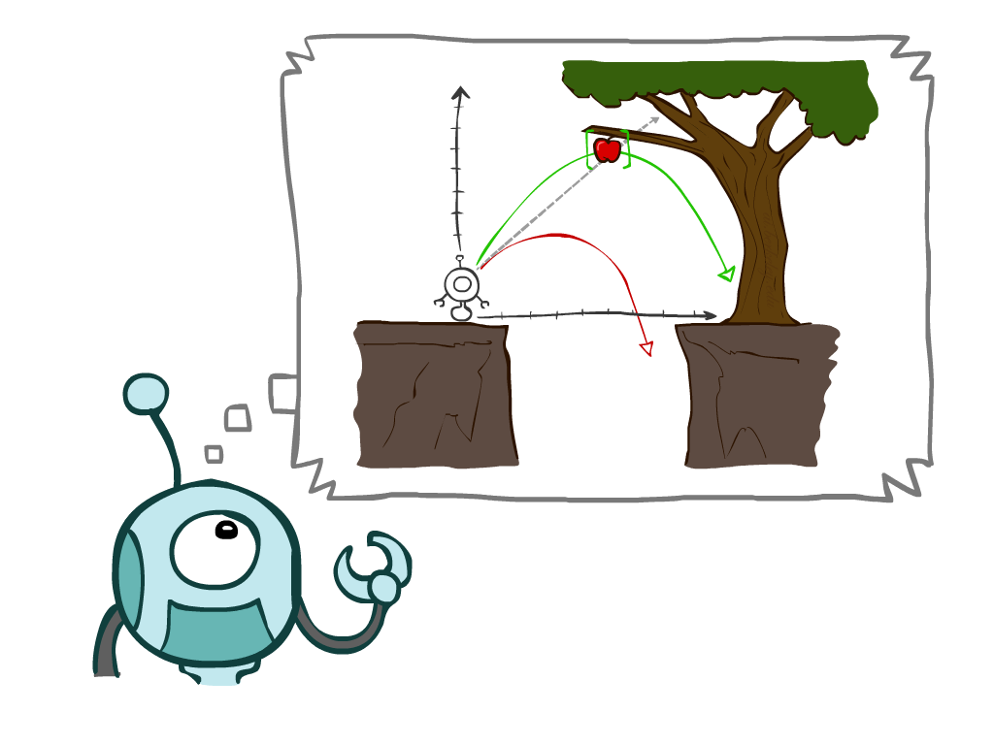
Recap
Agents that Plan Ahead
Search Problems
Uninformed Search Methods
Depth-First Search
Breadth-First Search
Uniform-Cost Search
Notes:
General theme in the class:
A goal we have in mind.
A mathematical abstraction to formalize this
Algorithms that operate on these abstractions

Slide 4
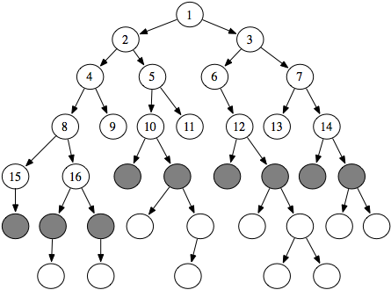
Questions: What is fringe?
Search space is usually represented as a graph
Nodes are states
Edges are the connections (or actions) between the corresponding states.
If you're performing a tree (or graph) search, then the set of all nodes at the end of all visited paths is called the fringe.
In the picture, the grey nodes (the lastly visited nodes of each path) form the fringe
Notes:
General theme in the class:
A goal we have in mind.
A mathematical abstraction to formalize this
Algorithms that operate on these abstractions

Slide 5
Today
Informed Search Methods
Greedy Search
A* Search
Graph searches
Notes:
General theme in the class:
A goal we have in mind.
A mathematical abstraction to formalize this
Algorithms that operate on these abstractions

Slide 6
Uninformed vs. Informed Search
Uninformed search
Given no information about problem (other than its definition)
Find solutions to problems by systematically generating new states and testing for goal
Informed search
Given some ideas of where to look for solutions
Use problem-specific knowledge

Slide 7
Uninformed vs. Informed Search
Uninformed search
Given no information about problem (other than its definition)
Find solutions to problems by systematically generating new states and testing for goal
Informed search
Given some ideas of where to look for solutions
Use problem-specific knowledge

Slide 8
Example: Pancake Problem
Cost: Number of pancakes flipped
Notes:
Gates, W. and Papadimitriou, C., "Bounds for Sorting by Prefix Reversal.", Discrete Mathematics. 27, 47-57, 1979.

Slide 9
Example: Pancake Problem
State space graph with costs as weights
S
4
2
3
2
3
4
G
3
4
2
3
2
2
4
3
Notes:
A* expanded 8100 ; Path cost = 33
UCS expanded 25263 . Path cost = 33
Greedy expanded 10 . Path cost = 41
[0, 7, 5, 3, 2, 1, 4, 6]
(7, 0, 5, 3, 2, 1, 4, 6)
(6, 4, 1, 2, 3, 5, 0, 7)
(3, 2, 1, 4, 6, 5, 0, 7)
(1, 2, 3, 4, 6, 5, 0, 7)
(5, 6, 4, 3, 2, 1, 0, 7)
(6, 5, 4, 3, 2, 1, 0, 7)
(0, 1, 2, 3, 4, 5, 6, 7)

Slide 10
General Tree Search
Action: flip top two Cost: 2
Action: flip all four Cost: 4
Path to reach goal:
Flip four, flip three
Total cost: 7
Notes:
You know exactly where you came from and how you got there, but you have no idea where you’re going. But, you’ll know it when you see it.

Slide 11


Uninformed Search vs Informed Search
Uninformed
Informed

Slide 12
Search Heuristics
A heuristic is
A function that estimates how close a state is to a goal
Designed for a particular search problem
Examples: Manhattan distance, Euclidean distance for pathing
not the exact “path” distance

Slide 13
Example: Heuristic Function
h(x)

Slide 14
Example: Heuristic Function
Heuristic: the number of the largest pancake that is still out of place
3
h(x)
4
3
4
3
0
4
4
3
4
4
2
3
Notes:
A* expanded 8100 ; Path cost = 33
UCS expanded 25263 . Path cost = 33
Greedy expanded 10 . Path cost = 41
[0, 7, 5, 3, 2, 1, 4, 6]
(7, 0, 5, 3, 2, 1, 4, 6)
(6, 4, 1, 2, 3, 5, 0, 7)
(3, 2, 1, 4, 6, 5, 0, 7)
(1, 2, 3, 4, 6, 5, 0, 7)
(5, 6, 4, 3, 2, 1, 0, 7)
(6, 5, 4, 3, 2, 1, 0, 7)
(0, 1, 2, 3, 4, 5, 6, 7)

Slide 15

Greedy Search

Slide 16
Example: Heuristic Function
h(x)

Slide 17
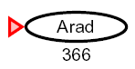
Greedy Search
Expand the node that seems closest…
What can go wrong?
Does not guarantee the optimal solution

Slide 18
Greedy Search
b
Strategy: expand a node that you think is closest to a goal state
Heuristic: estimate of distance to nearest goal for each state
A common case:
Best-first takes you straight to the (wrong) goal
Worst-case: like a badly-guided DFS
…
b
…
Notes:
For any search problem, you know the goal. Now, you have an idea of how far away you are from the goal.

Slide 19
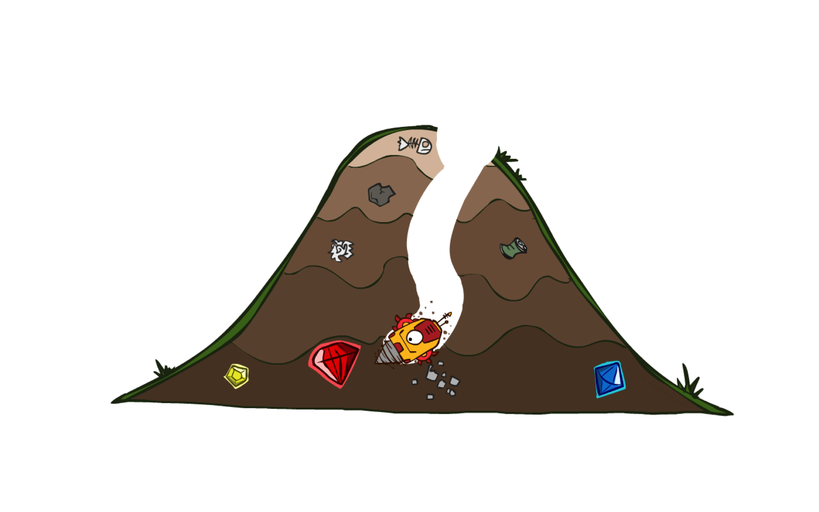
A* Search

Slide 20



A* Search
UCS
Greedy
A*
Notes:
Notes: these images licensed from iStockphoto for UC Berkeley use.

Slide 21
Combining UCS and Greedy
Uniform-cost orders by path cost, or backward cost g(n)
Greedy orders by goal proximity, or forward cost h(n)
A* Search orders by the sum: f(n) = g(n) + h(n)
8
g = 0 h=6
S
e
h=1
g = 1 h=5
a
1
1
3
2
g = 2 h=6
g = 9 h=1
S
a
d
G
b
d
g = 4 h=2
e
h=6
1
h=5
h=2
h=0
1
g = 3 h=7
g = 6 h=0
g = 10 h=2
c
b
c
G
d
h=7
h=6
g = 12 h=0
G

Slide 22
When Should we terminate A*
Should we stop when we enqueue a goal?
No: only stop when we dequeue a goal
A
2
2
S
h = 3
h = 0
G
2
B
3
h = 1

Slide 23
Is A* Optimal?
h = 6
1
A
3
S
h = 7
G
h = 0
5
What went wrong?
Actual bad goal cost < estimated good goal cost
We need estimates to be less than actual costs!

Slide 24


Idea: Admissibility
Inadmissible (pessimistic) heuristics break optimality by trapping good plans on the fringe
Admissible (optimistic) heuristics slow down bad plans but never outweigh true costs

Slide 25


Admissible Heuristics
A heuristic h is admissible (optimistic) if:
where is the true cost to a nearest goal
Coming up with admissible heuristics is most of what’s involved in using A* in practice.

Slide 26

Optimality of A* Tree Search

Slide 27


Optimality of A* Tree Search
Assume:
A is an optimal goal node
B is a suboptimal goal node
h is admissible
Claim:
A will exit the fringe before B
…

Slide 28


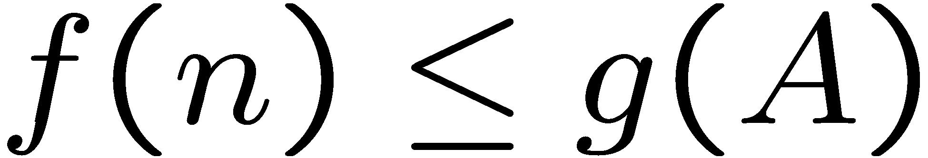
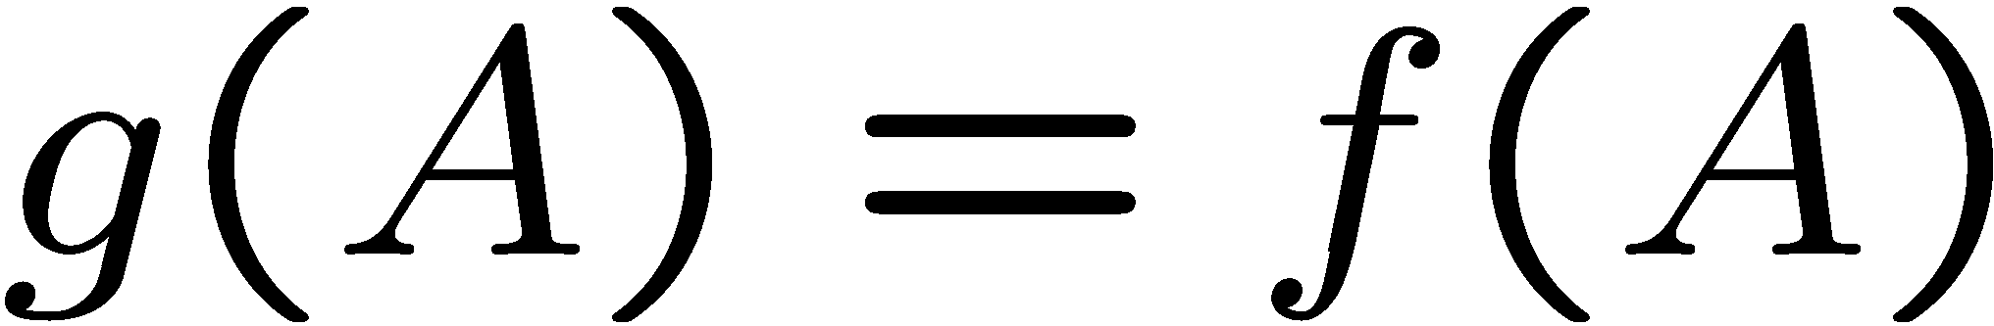
Optimality of A* Tree Search: Blocking
Proof:
Imagine B is on the fringe
Some ancestor n of A is on the fringe, too (maybe A!)
Claim: n will be expanded before B
f(n) is less or equal to f(A)
…
Definition of f-cost
Admissibility of h
h = 0 at a goal

Slide 29


Optimality of A* Tree Search: Blocking
Proof:
Imagine B is on the fringe
Some ancestor n of A is on the fringe, too (maybe A!)
Claim: n will be expanded before B
f(n) is less or equal to f(A)
f(A) is less than f(B)
…
B is suboptimal
h = 0 at a goal

Slide 30

Optimality of A* Tree Search: Blocking
Proof:
Imagine B is on the fringe
Some ancestor n of A is on the fringe, too (maybe A!)
Claim: n will be expanded before B
f(n) is less or equal to f(A)
f(A) is less than f(B)
n expands before B
All ancestors of A expand before B
A expands before B
A* search is optimal
…

Slide 31
UCS vs. A* Contours
Uniform-cost expands equally in all “directions”
A* expands mainly toward the goal, but does hedge its bets to ensure optimality
Start
Goal
Start
Goal

Slide 32



Comparison
Greedy
Uniform Cost
A*

Slide 33
A* Applications
Video games
Pathing / routing problems
Resource planning problems
Robot motion planning
Language analysis
Machine translation
Speech recognition
…

Slide 34

Creating Admissible Heuristics
Most of the work in solving hard search problems optimally is in coming up with admissible heuristics
Often, admissible heuristics are solutions to relaxed problems, where new actions are available
Inadmissible heuristics are often useful too
366
15

Slide 35
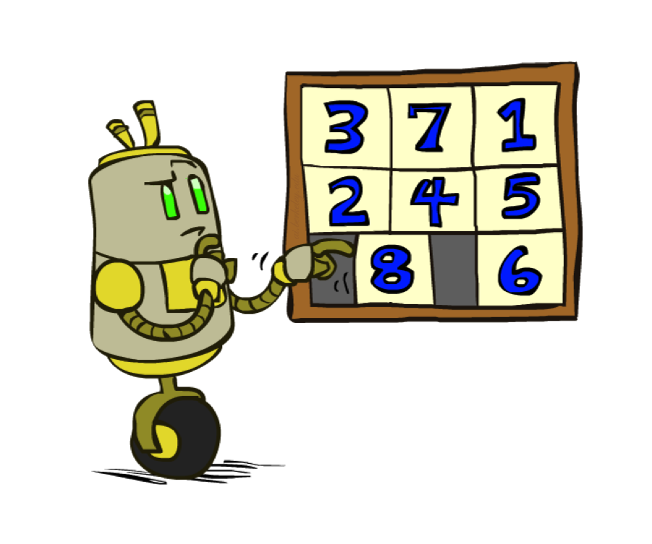
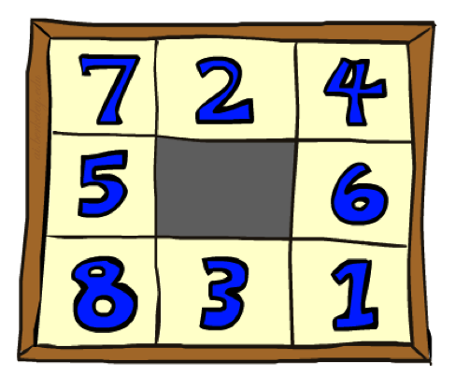
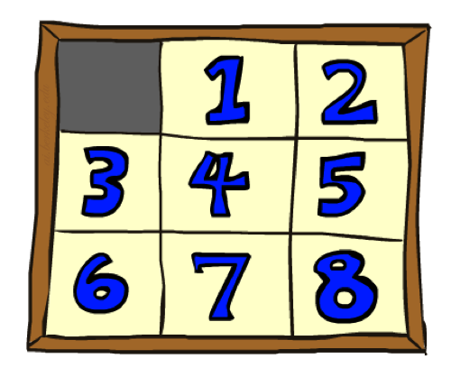
Example: 8 Puzzle
Start State
Actions
Goal State
What are the states?
How many states?
What are the actions?
How many successors from the start state?
What should the costs be?

Slide 36
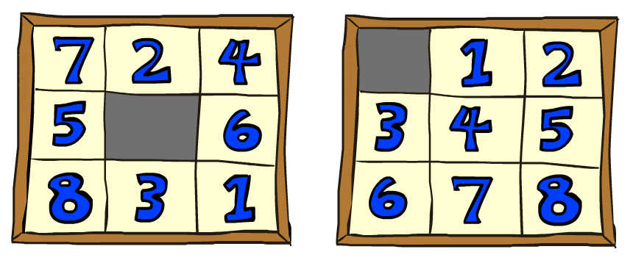
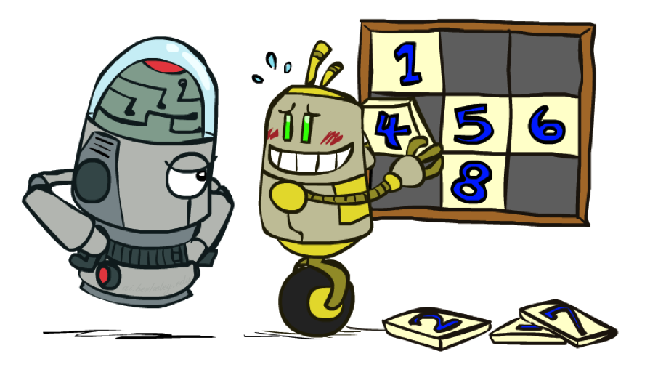
8 Puzzle I
Heuristic: Number of tiles misplaced
Why is it admissible?
h(start) =
This is a relaxed-problem heuristic
8
Start State
Goal State
 | Average nodes expanded when the optimal path has…
 | …4 steps | …8 steps | …12 steps
UCS | 112 | 6,300 | 3.6 x 10⁶
TILES | 13 | 39 | 227
Statistics from Andrew Moore

Slide 37
8 Puzzle II
What if we had an easier 8-puzzle where any tile could slide any direction at any time, ignoring other tiles?
Total Manhattan distance
Why is it admissible?
h(start) =
Start State
Goal State
 | Average nodes expanded when the optimal path has…
 | …4 steps | …8 steps | …12 steps
TILES | 13 | 39 | 227
MANHATTAN | 12 | 25 | 73
3 + 1 + 2 + … = 18

Slide 38
8 Puzzle III
How about using the actual cost as a heuristic?
Would it be admissible?
Would we save on nodes expanded?
What’s wrong with it?
With A*: a trade-off between quality of estimate and work per node
As heuristics get closer to the true cost, you will expand fewer nodes but usually do more work per node to compute the heuristic itself

Slide 39
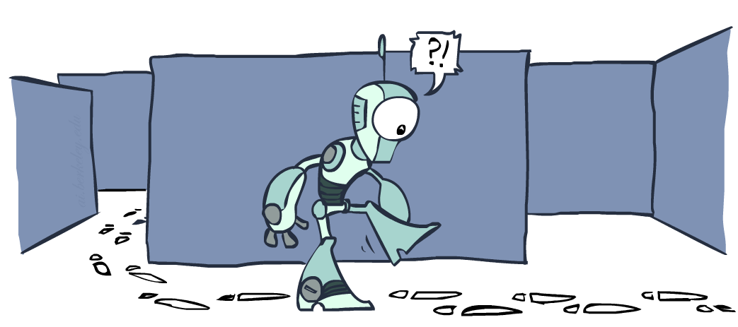
Graph Search

Slide 40
Tree Search: Extra Work!
Failure to detect repeated states can cause exponentially more work.
State Graph
Search Tree

Slide 41
Graph Search
In BFS, for example, we shouldn’t bother expanding the circled nodes (why?)
S
d
e
p
b
c
e
h
r
q
a
a
h
r
p
q
f
p
q
f
q
c
G
q
c
G
a
a

Slide 42
Graph Search
Idea: never expand a state twice
How to implement:
Tree search + set of expanded states (“closed set”)
Expand the search tree node-by-node, but…
Before expanding a node, check to make sure its state has never been expanded before
If not new, skip it, if new add to closed set
Important: store the closed set as a set, not a list
Can graph search wreck completeness? Why/why not?
How about optimality?

Slide 43
A* Graph Search Gone Wrong?
State space graph
Search tree
A
S (0+2)
1
S
1
C
h=4
h=1
A (1+4)
B (1+1)
h=2
1
2
B
3
C (2+1)
C (3+1)
h=1
G
G (5+0)
G (6+0)
h=0

Slide 44
Consistency of Heuristics
Main idea: estimated heuristic costs ≤ actual costs
Admissibility: heuristic cost ≤ actual cost to goal
h(A) ≤ actual cost from A to G
Consistency: heuristic “arc” cost ≤ actual cost for each arc
h(A) – h(C) ≤ cost(A to C)
Consequences of consistency:
The f value along a path never decreases
h(A) ≤ cost(A to C) + h(C)
A* graph search is optimal
A
1
C
h=4
h=1
h=2
3
G

Slide 45
Optimality of A* Graph Search

Slide 46
Optimality of A* Graph Search
Sketch: consider what A* does with a consistent heuristic:
Fact 1: In tree search, A* expands nodes in increasing total f value (f-contours)
Fact 2: For every state s, nodes that reach s optimally are expanded before nodes that reaches sub-optimally
Result: A* graph search is optimal
…
f ≤ 1
f ≤ 2
f ≤ 3

Slide 47
Optimality
Tree search:
A* is optimal if heuristic is admissible
UCS is a special case (h = 0)
Graph search:
A* optimal if heuristic is consistent
UCS optimal (h = 0 is consistent)
Consistency implies admissibility
In general, most natural admissible heuristics tend to be consistent, especially if from relaxed problems

Slide 48
A*: Summary
A* uses both backward costs and (estimates of) forward costs
A* is optimal with admissible / consistent heuristics
Heuristic design is key: often use relaxed problems

Slide 49
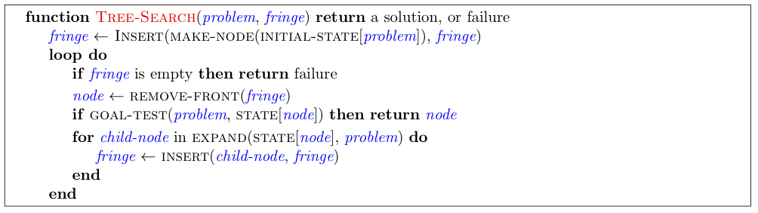
Tree Search Pseudo-Code

Slide 50
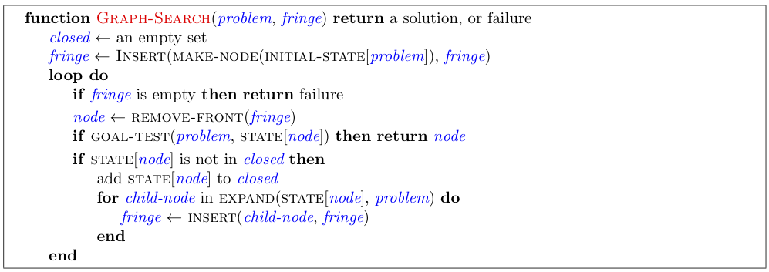
Graph Search Pseudo-Code

Slide 51
Optimality of A* Graph Search
Consider what A* does:
Expands nodes in increasing total f value (f-contours) Reminder: f(n) = g(n) + h(n) = cost to n + heuristic
Proof idea: the optimal goal(s) have the lowest f value, so it must get expanded first
…
f ≤ 1
f ≤ 2
f ≤ 3
There’s a problem with this argument. What are we assuming is true?

Slide 52


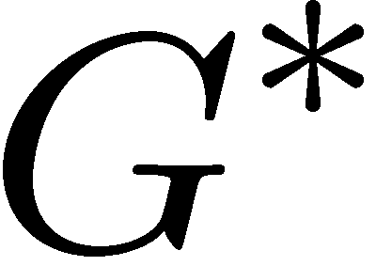

Optimality of A* Graph Search
Proof:
New possible problem: some n on path to G* isn’t in queue when we need it, because some worse n’ for the same state dequeued and expanded first (disaster!)
Take the highest such n in tree
Let p be the ancestor of n that was on the queue when n’ was popped
f(p) < f(n) because of consistency
f(n) < f(n’) because n’ is suboptimal
p would have been expanded before n’
Contradiction!

